Slide 1
Data-Driven Pricing Strategy for Big Mountain Resort
Increasing Revenue and Profit with Model-Based Recommendations
Garrett Harrison — February 12, 2023

Slide 2
Introduction
Problem Statement
Big Mountain Resort aims to increase its revenue by 15% and profit by 20% by the end of the next ski season (12 months). To achieve this, a data-driven pricing strategy is needed that considers the value customers place on the resort's facilities and services.

Slide 3
Recommendations
Key Findings
Based on the modeling, Big Mountain could increase its ticket price to $104.03 from $81, but the company should conduct further analysis of the market and competitors' pricing strategies.
A slight increase in ticket prices could absorb the cost of a new features, such as an additional chair lift.
The company could also test potential run closures through customer surveys and monitor ski traffic and ticket sales to adjust their plans based on the results.

Slide 4
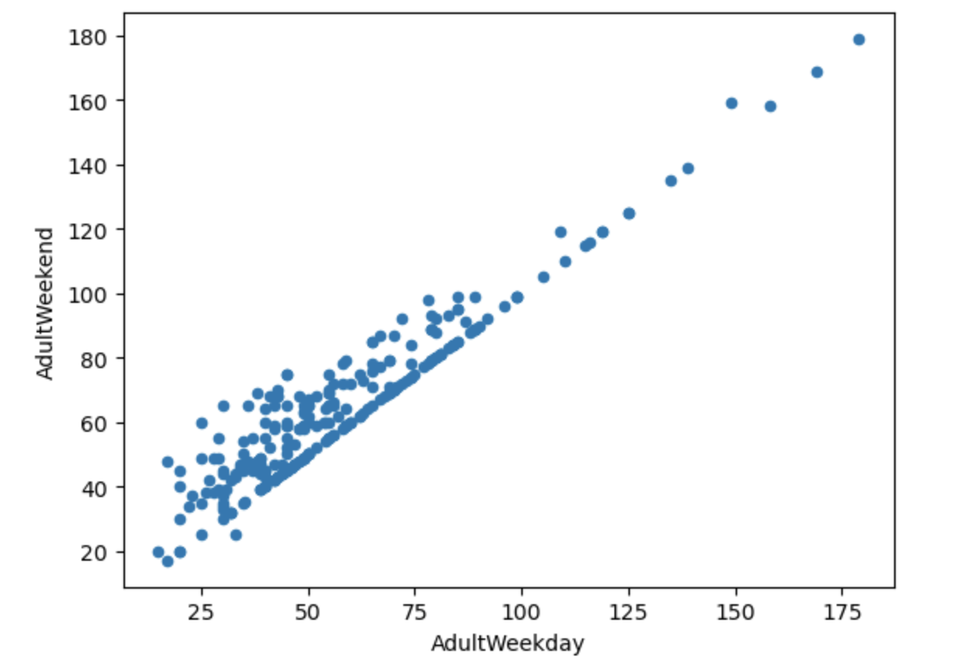
Modeling Results and Analysis
Adult Weekday to Weekend Ratio
To focus on one ticket price variable, a target price point was modeled to predict corresponding prices.

Slide 5
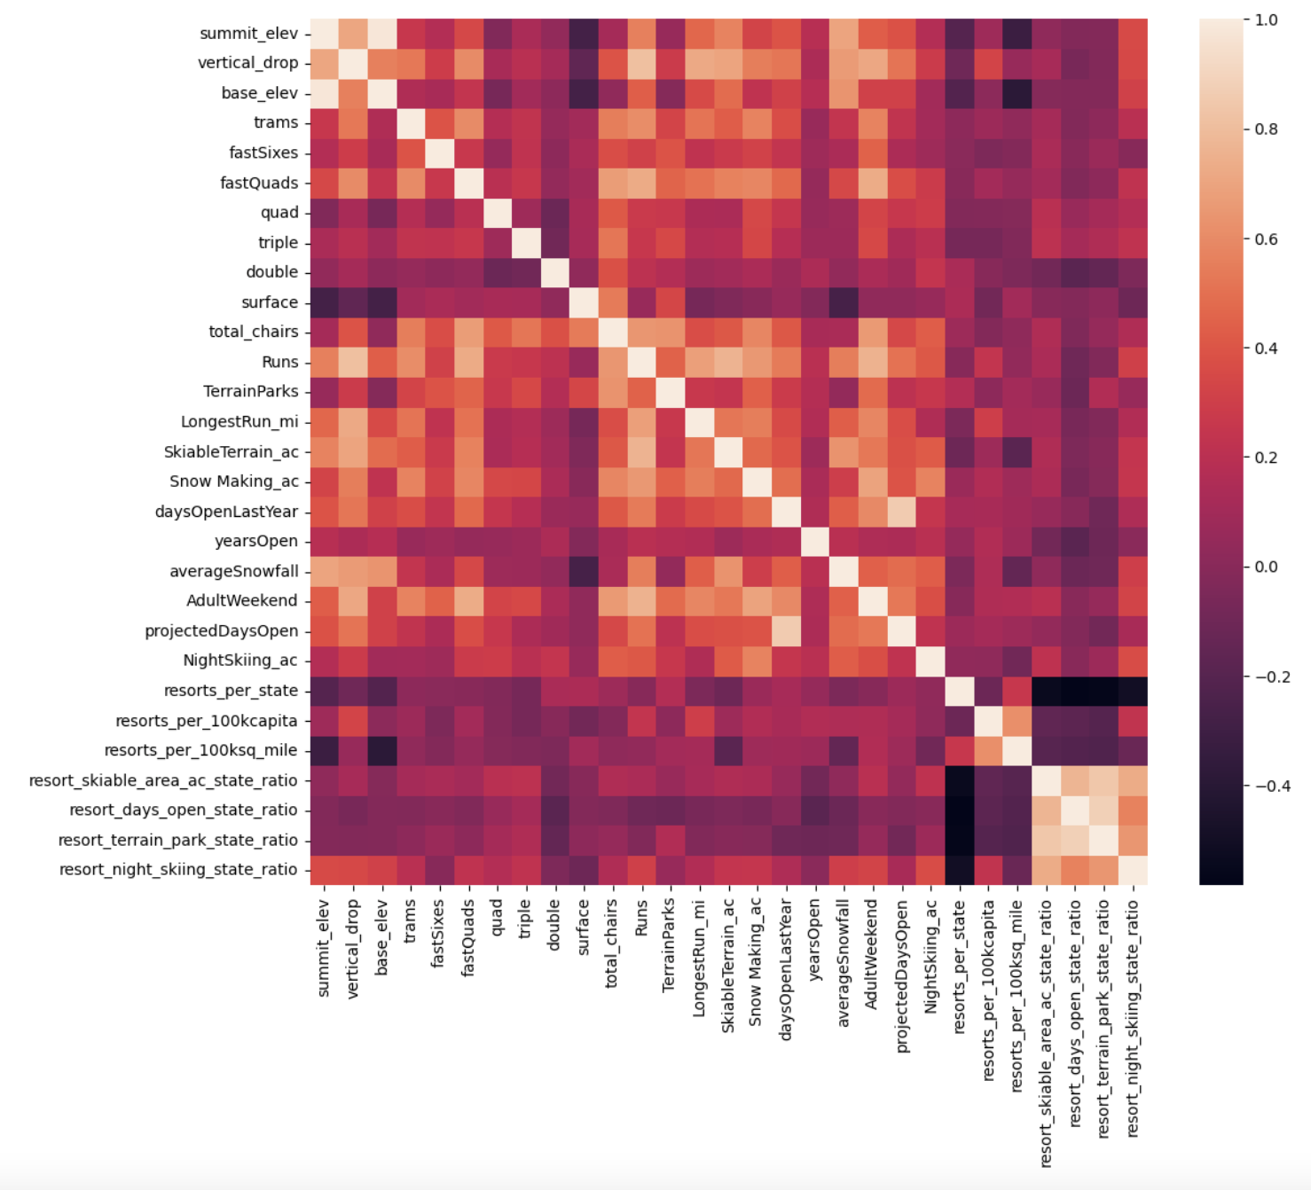
Exploratory Analysis
Feature Correlation Heat Map
The ratio of chairs to runs was found to have a negative correlation with the ticket price (dark color).
While vertical drop, fast quads, runs, and total chairs were useful features for predicting ticket prices (light color).
Multicollinearity, non-linear relationships, and outliers were considered in feature selection.

Slide 6
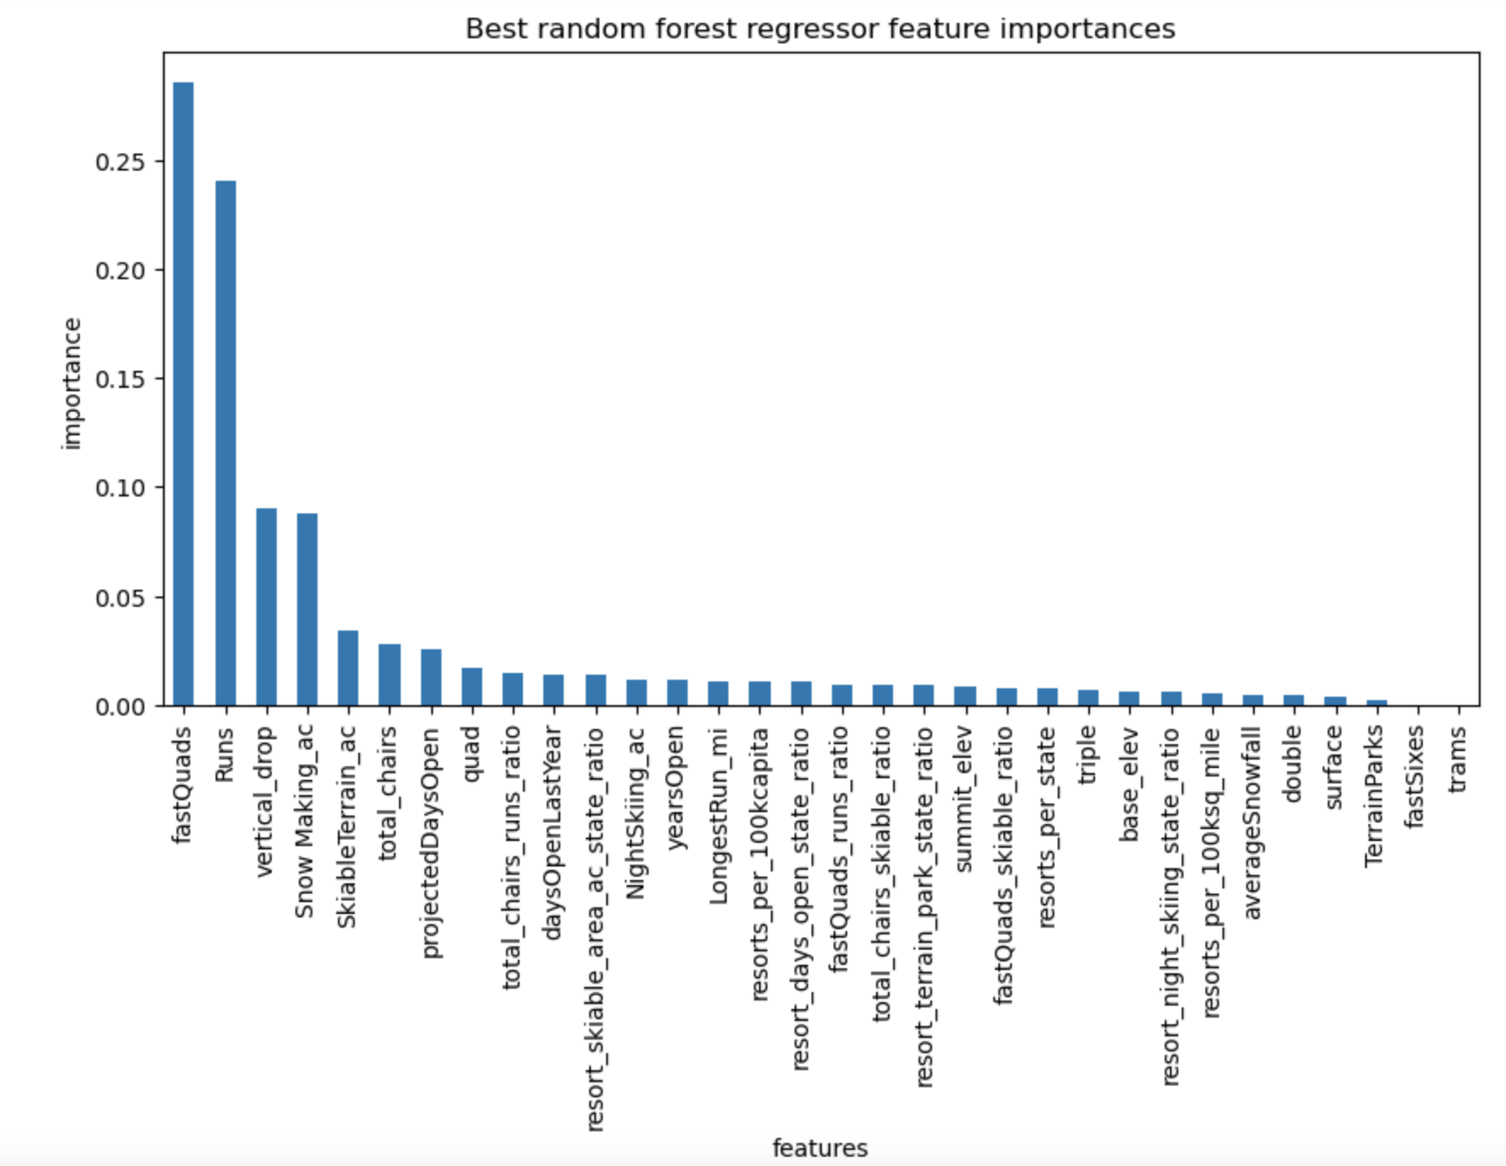
Preprocessing and Training
Forest Regression Model
Mean absolute error, essentially, tells states that, on average, one might expect to be off by around $19 if one guessed ticket price based on an average of known values.
The performance of the simple linear regression model was calculated (to be within $9 of the real price
The random forest regressor outperformed the linear regression model due to its ability to handle non-linear relationships between features and the target variable (off by $1).

Slide 7
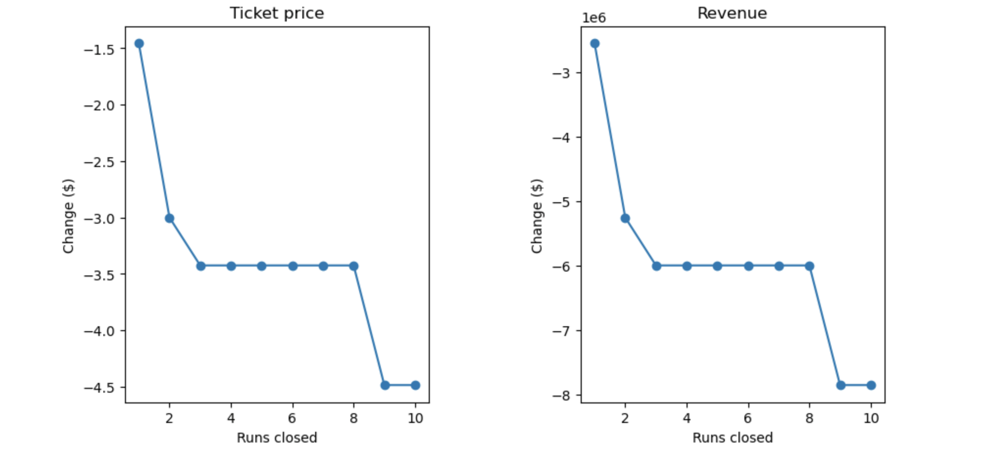
Modeling
Scenario Modeling
The random forest regressor was used to estimate the cost of a new chair lift and potential run closures.

Slide 8
Conclusion
The use of a data-driven approach to pricing strategy can help Big Mountain Resort increase its revenue and profit.
The random forest regressor was the best model for predicting ticket prices based on its performance and ability to handle non-linear relationships.
Big Mountain could increase its ticket price to $104.03, but additional analysis is necessary to determine if this price point is competitive.
Future work could involve additional analysis of the market and competitors' pricing strategies, testing potential run closures through customer feedback, and monitoring ski traffic and ticket sales to adjust plans accordingly.
Additionally, Big Mountain Resort could consider additional features, such as snow quality and weather, in its pricing strategy.

